Slide 1

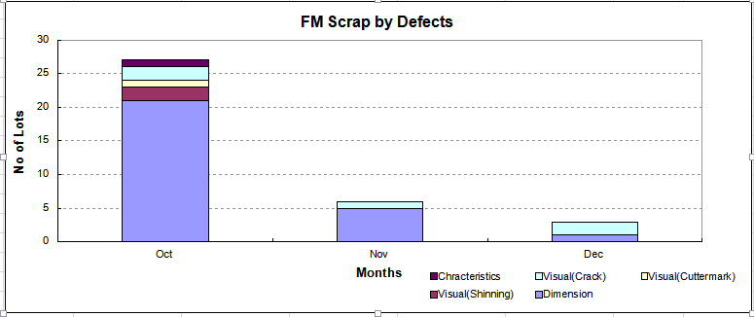
FOREIGN WORKERS HIRING
Subject : Foreign Workers selection
Country : Myanmar (Yangon City)
Venue : Yuzana Hotel
Date : 12/09/2019 ~ 14/09/2019
Interviewer : Shahrudin & Seeni
Details of Selection
1. No. of 120 pax candidates interviewed a) Male - 74 pax
b) Female - 46 pax
2. No.of 54 pax candidates selected a) Male - 41 pax
b) Female - 13 pax
3 . All selected candidates are readily with passport except some are wating for
medical report. Their medical report are expected to be completed by 19th Sep
2019.
4. Balance of foreign worker approval is 31 pax. To proceed with Indonesian workers
selection. Schedule 20/09/2019

